Slide 1
Design Patterns : Solution to Software Design Problems
View Design Patterns course details at www.edureka.co/design-patterns
For Queries:
Post on Twitter @edurekaIN: #askEdureka
Post on Facebook /edurekaIN
For more details please contact us:
US : 1800 275 9730 (toll free)
INDIA : +91 88808 62004
Email us : webinars@edureka.co

Slide 2
Objectives
At the end of this session, you will be able to:
Know what are Software Design Patterns
Understand the need of Software Design Patterns
Distribute Responsibility using Chain Of Responsibility Pattern
Communicate among objects with Mediator Pattern
Understand Observer Patterns

Slide 3
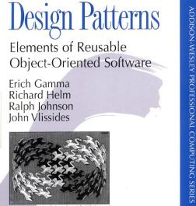
Software Design Patterns & Gang Of Four(GOF)
Software design patterns describe relationship among classes to solve a general and repeatable design problem in a specific context with proven solution
Anyone who knows something about Software Design Patterns will certainly be aware of famous book “Elements of Reusable Object-Oriented Software” written by Erich Gamma, Richard Helm, Ralph Johnson and John Vlissides popularly knows as Gang Of Four(GOF)
This is the most popular book written on Software Design Patterns by Erich Gamma, Richard Helm, Ralph Johnson and John Vlissides, known as Gang Of Four

Slide 4
Classification of Software Design Patterns
Software Design Patterns
Factory Pattern
Object Pool Pattern
Structural Design Pattern
Adapter Pattern
Decorator Pattern
Creational Design Pattern
Singleton Pattern
Composite Pattern
Behavioral Design Pattern
Chain of Responsibility Pattern
Mediator Pattern
ObserverPattern
Concurrency Design Pattern
Reactor Pattern
Scheduler Pattern
Thread Pool Pattern
.
.
.
.
.
.
.
.
.
.
.
.

Slide 5
Importance of Design Patterns
Just knowing a Programming Language is not enough to engineer a software application
While building an application its important that we keep the future requirements and changes in mind otherwise you will have to change the code that you had written earlier
Building a large application is never easy, so its very important that you design it correctly and then start coding the application
Design Patterns provides efficient techniques to create a flexible application design

Slide 6

Chain of Responsibility (COR)
Chain Of Responsibility pattern gives more than one object a chance to handle the request
Sender of the request does not know which object in the chain will serve its request
In Chain Of Responsibility pattern a chain of request handlers is maintained, a handler decides whether it can handle the request or not, if not then it passes the request to next handler
Chain of Receiver
Request
Request
Request
Request
Receiver 1
Receiver 2
Receiver 3
Receiver N
Reference to Receiver 2
Reference to Receiver 3
Reference to Receiver 4
Cannot handle

Slide 7
Chain of Responsibility - UML Diagram
Handler - defines an interface for handling requests
ConcreteHandler - handles the requests it is responsible for .If it can handle the request it does so, otherwise it sends the request to its successor
Client - sends commands to the first object in the chain that may handle the command
Client
Handler
+HandleRequest()
ConcreteHandler1
+HandleRequest()
ConcreteHandler2
+HandleRequest()

Slide 8


Problem Statement
Customer support system is one of the implementation of this pattern, where users calls the help desk (L1 support) and tell their problem
Resolved
YES
NO
Resolved
YES
NO
Cannot handle
Problem Statement
L1 Support
L2 Support
Request goes through multiple objects (handlers)

Slide 9
Solution
Using Chain of responsibility simplifies the request object because it does not have to know the chain’s structure and keep direct references to its members
In this case, user simply interact with help desk and the request internally goes through multiple handlers
User does not need to know about the different handlers

Slide 10
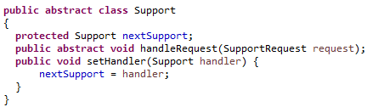
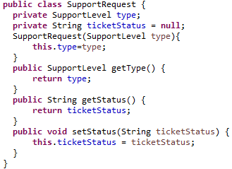
Implementing Chain of Responsibility
All support levels will have to inherit the support class and implement the handleRequest()
Client (user) will generate a SupportRequest (a ticket)

Slide 11
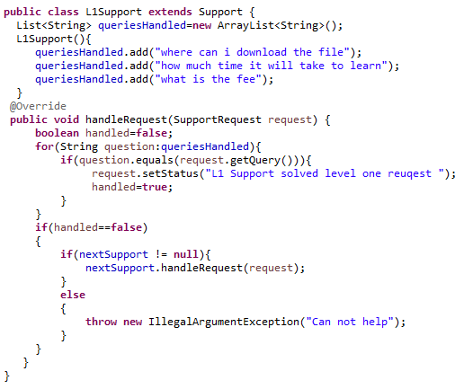
Implementing Chain of Responsibility (Contd.)

Slide 12
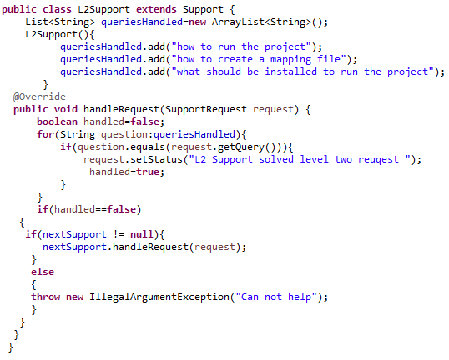
Implementing Chain of Responsibility (Contd.)

Slide 13
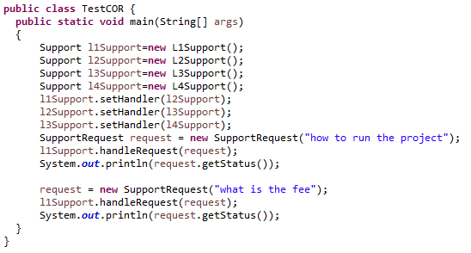

Implementing Chain of Responsibility (Contd.)
Here we are creating chain of responsible objects for handling the support request according to user query
Output
All the support requests will first go to L1 support

Slide 14


Other Uses Of Chain of Responsibility
One of the most important use of Chain Of Responsibility pattern is to implement filter mechanism
Here one filter process the request and then passes on to next filter in the chain, similarly next filter processes the request and then passes onto next filter in chain
JavaEE API uses Chain Of Responsibility pattern to implement filter mechanism using the following doFilter() method
javax.servlet.Filter#doFilter(ServletRequest request, ServletResponse response, FilterChain chain)
Request
Servlet
Logging Filter
Authentication Filter
JAX-WS also uses Chain Of Responsibility pattern to implement JWS Handler Framework, which allows manipulation of SOAP messages

Slide 15

Mediator Pattern
The mediator pattern promotes loose coupling of objects by removing the need for classes to communicate with each other directly
Instead, mediator objects are used to encapsulate and centralize the interactions between classes
Mediator pattern simplifies communication in general when a program contains large number of classes that interact
Each class only needs to know how to pass messages to its mediator, rather than to numerous colleagues

Slide 16
Mediator Pattern – UML Diagram
Mediator - defines an interface for communicating with Colleague objects
ConcreteMediator - knows the colleague classes and keep a reference to the colleague objects
Colleague classes - keep a reference to its Mediator object
Mediator
Colleague
ConcreteMediator
ConcreteColleagueA
ConcreteColleagueB

Slide 17

Problem Statement
Suppose you have to create a chat application where multiple users can chat together
Rather than each user sending the message directly to other users, we can use mediator pattern to implement this design

Slide 18

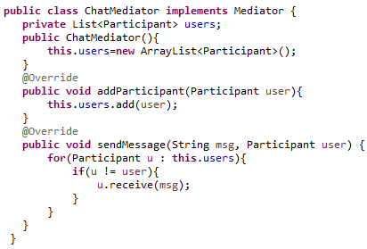
Implementing Mediator Pattern
ChatMediator keeps the reference of all the users

Slide 19
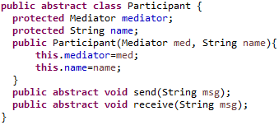
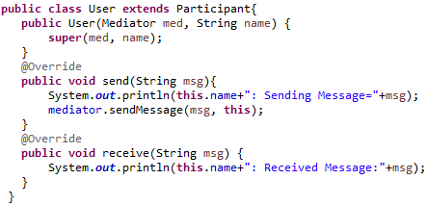
Implementing Mediator Pattern (Contd.)
A User doesn’t have any reference to other users

Slide 20
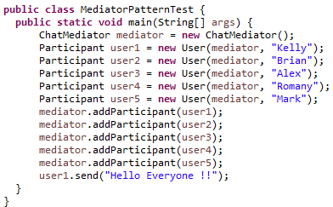

Implementing Mediator Pattern (Contd.)
Output

Slide 21
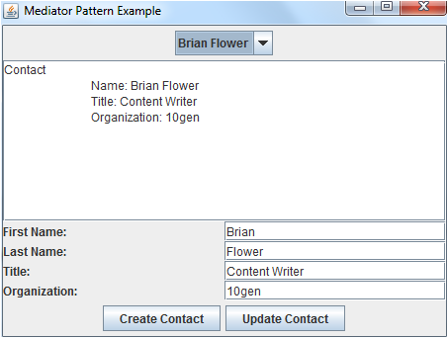
Implementing Mediator Pattern (Contd.)
All GUI applications consists of small components like Windows, Panel etc.
Each Panel contains a group of GUI element
These panels have to co-ordinate among themselves
As in this application, whenever a contact is selected from the drop down box, its details should be updated in the ContactDisplayPanel and ContactEditorPanel
Rather then one panel having reference of all other panels, we can use Mediator Pattern to simplify the communication between panel objects
ContactSelectorPanel
ContactDisplayPanel
ContactEditorPanel

Slide 22
Observer Pattern
Observer:
There is someone watching you
Observer
Observes
Subject
notify

Slide 23
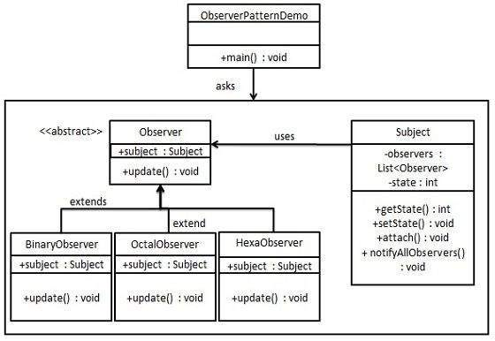
Observer Pattern
Reference : tutorialspoint.com

Slide 24
Conclusion
Similarly there are other design patterns to solve majority of the problems that software designers encounter during their day to day activities
Design patterns compliments ones experience and helps them deliver wonderful and successful software designs
They serve as common nomenclature or jargon that architects can easily communicate with others in software industry
Software design is no more an art. It’s a skill one can learn. And thanks to design patterns

